Slide 1


Slide 2
We will study
Class definition,
adding variables and methods,
creating objects, constructors,
defining methods, calling methods
Other Object Oriented Concepts like Inheritance, Polymorphism will be studies later

Slide 3





Slide 4


Slide 5

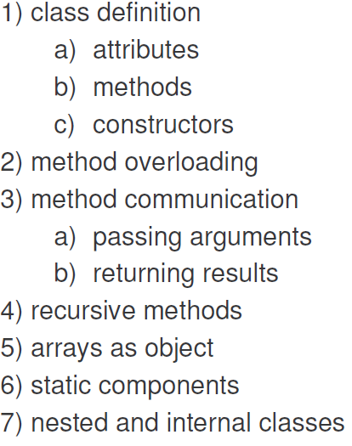

Slide 6
1) a class is a template for objects 2) an object is an instance of a class
Lets see an example

Slide 7
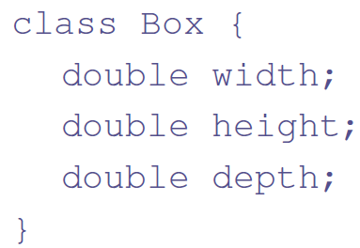
Write a Program to construct a Box object having width, height and depth variables. Calculate the volume
You can add a new Class “Box” to the existing package in NetBeans
Lets create the objects and initialize the variables

Slide 8
class BoxDemo
{
public static void main(String args[])
{
Box myBox; //Reference
myBox = new Box(); //Reference referring to addr. of object
//Lets Print the variables of Object myBox
System.out.print(“Values are “);
System.out.println(myBox.width+ “ “ + myBox.height+ “ “+ myBox.depth);
// Prints 0 0 0
//Lets assign values to variables
myBox.width=20.5; myBox.height = 30.2; myBox.depth=15.2;
//Calculate Volume
double vol=myBox.width * myBox.height * myBox.depth;
// Print Volume
System.out.println (“Volume=“ + vol);
}

Slide 9

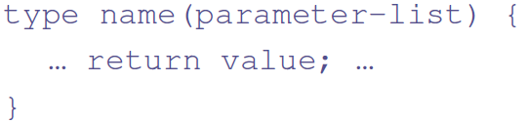
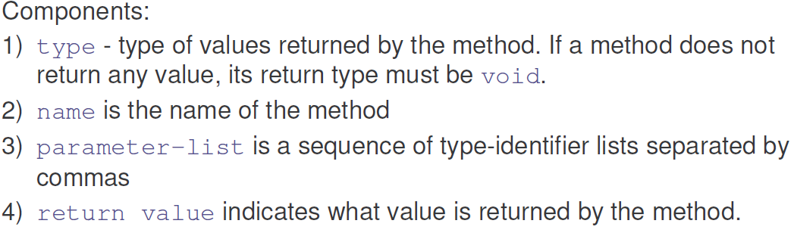

Slide 10
Lets add a method that calculates volume to the Box class
class Box
{
double width, height, depth;//Instance variables
//double width=10, height=20, depth=30;//OK
void volume() //Method
{
int i=0;//Can have local variables. Must be initialized
System.out.print("Volume is ");
System.out.println(width * height * depth);
}
}

Slide 11
class BoxDemo
{
public static void main(String args[])
{
Box mybox1 = new Box();//Object 1
Box mybox2 = new Box();//Object 2
mybox1.width = 10; mybox2.width = 3;
mybox1.height = 20; mybox2.height = 6;
mybox1.depth = 15; mybox2.depth = 9;
mybox1.volume(); //Invoke a Method
mybox2.volume();
}
}

Slide 12
Methods can also return and accept values. Lets understand
Write a Box program with methods
to set the values to variables and
to calculate volume

Slide 13
class Box
{
double width;
double height;
double depth;
void setDim(double w, double h, double d) ////Parameterized
{
width = w; height = h; depth = d;
}
double volume() //Non parameterized
{
return width * height * depth;
}
}
//Inside main method
Box myBox=new Box();
myBox.setDim(10.0, 20.0, 30.0);
System.out.println ( mybox.volume() );

Slide 14
Can a method Returning an Array ?
Yes!
Write a Program to demonstrate a method returning an array

Slide 15
Can a method Returning an Array ?
class Box
{
double width=12.0, height=22.2, depth=33.4;
double [ ] valueInArray() //Method returning an array
{
double dA[ ]= {width ; height ; depth};
return dA; //Return an Array
}
}
class TestClass
{
public static void main (String args[ ])
{
MyData obj=new MyData();
double dArray[ ]=obj.valueInArray();
for (int i=0; i<dArray.length; i++)
System.out.println(dArray[i]);
}
}

Slide 16

Properties
It is syntactically similar to A method
It has the same name as its class
It is written without return type;
When the class has no constructor, the default constructor automatically initializes all its instance variables with zero.
Lets write a Box Program with constructor

Slide 17
class Box
{ double width; double height; double depth;
Box( ) // Constructor
{
width = 0.0; height = 0.0; depth = 0.0;
}
void setDim(double w, double h, double d) ////Parameterized
{
width = w; height = h; depth = d;
}
double volume()
{ return width * height * depth; }
}
Provide a class with main method to demonstrate the usage

Slide 18
Parameterized Constructor
Box(double w, double h, double d)
{
width = w; height = h; depth = d;
}
We invoke it as:
Box mybox1 = new Box(10.0, 20.5, 15.5);
Box mybox2 = new Box(3.0, 6.5, 9.5);

Slide 19
What is the error in this constructor?
Box(double width , double height , double depth )
{
width = width ; height = height ; depth = depth ;
}
Solution?
Box(double width , double height , double depth )
{
this.width = width ; this.height = height ; this.depth = depth ;
}

Slide 20
Write a Program to Creates a Stack to store 10 int elements

Slide 21
class Stack
{
int stck[ ] = new int[10];
int tos;
Stack()
{
tos = -1;
}
void push(int item)
{
if (tos==9)
System.out.println("Stack is full.");
else
stck[++tos] = item;
}

Slide 22
int pop()
{
if (tos < 0)
{
System.out.println("Stack underflow.");
return 0;
}
else
return stck[tos--];
}
}//end of class Stack

Slide 23
class TestStack
{
public static void main(String args[])
{
Stack mystack1 = new Stack();
for (int i=0; i<10; i++)
mystack1.push(i);
System.out.println(“Data in mystack1:");
for(int i=0; i<10; i++)
System.out.println(mystack1.pop());
}
}
// SLIDE 285

Slide 24

In Java, those objects which are NOT referenced by any reference are removed from the Heap
This is an Automatic process called Garbage Collection.
You can call the Garbage collector:
System.gc()

Slide 25
How to find execution time of a Program?
Make use of methods of System class as below:
In main method use the following code.
long startTime = System.nanoTime();//Nano sec.
Program goes here…….
long endTime = System.nanoTime();
long totalTime = endTime – startTime;
System.out.println(totalTime/1e9);//In second

